Slide 1
Course - DT228/1
Information Technology Fundamentals
INFORMATION TECHNOLOGY (IT) PROFESSIONALS

Slide 2
People in the Organisation
People are an organisation’s most important asset.
The tasks of a manager are essentially people-oriented. Unless there is some understanding of people, management will be unsuccessful.
Poor people management is an important contributor to project failure.

Slide 3
Information System as a Project
An information system will usually need to be built.
The building of an information system will be a major project, usually.
A project makes the system build manageable – controllable.
Project management needs a project manager.

Slide 4
Manager of a Project
The Project Manager:
Defines and reviews deliverables,
Estimates resources,
Plans, schedules and tracks tasks,
Assesses risk,
Resolves issues.

Slide 5
Project Manager or IT Manager?
Is the Project Manager the same as an IT Manager?
Strictly speaking, no.
What is the difference?
A Project Manager manages a technical project – at a project level.
An Information Technology Manager manages all aspects of IT – at a departmental level.

Slide 6
Project Manager or IT Manager? (2)
Common to both Project Manager and IT Manager:
they control hardware, software, network (probably) and personnel assets for their ‘area’.
A project manager manages;
low-level, technical hardware, software and people for project development.
IT Manager manages;
‘broad-ranging’ hardware, software and people for keeping the affected departments running smoothly with their systems in place.

Slide 7
Selecting Team Staff
An important project management task is team selection.
Information on selection comes from:
Information provided by the candidates.
Information gained by interviewing and talking with candidates.
Recommendations and comments from other people who know or who have worked with the candidates.

Slide 8
Issues Around Team Building
Managers in a company may not wish to lose people to a new project. Part-time involvement may be inevitable.
Skills such as User Interface Design and hardware interfacing are in short supply.
Recent graduates may not have specific skills, but this fact may be a way of introducing new skills.
Technical proficiency may be less important than social skills.

Slide 9
People Management Factors
Consistency
Team members should all be treated in a comparable way without favourites or discrimination.
Respect
Different team members have different skills and these differences should be respected.
Inclusion
Involve all team members and make sure that people’s views are considered.
Honesty
You should always be honest about what is going well and what is going badly in a project.

Slide 10
Motivating People
An important role of a manager is to motivate the people working on a project.
Motivation is a complex issue but it appears that their are different types of motivation based on:
Basic needs (e.g. food, sleep, etc.);
Personal needs (e.g. respect, self-esteem);
Social needs (e.g. to be accepted as part of a group).

Slide 11
Personality Types
The needs hierarchy is almost certainly an over-simplification of motivation in practice.
Motivation should also take into account different personality types:
Task-oriented;
Self-oriented;
Interaction-oriented.

Slide 12
The Team and The Project
The Project Team itself
A group responsible for the actual work in the project.
Headed by a Project Manager who reports to the Steering Committee on/for the project.
This leader is normally a senior member of the Information Technology staff.

Slide 13
The Team and The Project (2)
The Project Steering Committee
Initiates formal communication procedures between groups involved in the project.
Helps ensure that all planned deliverables are on time and within budget.
Reviews and approves all project plans.
Authorises commitment of resources.
Approves or disproves continuance of the project.
Evaluates the post-implementation review.

Slide 14
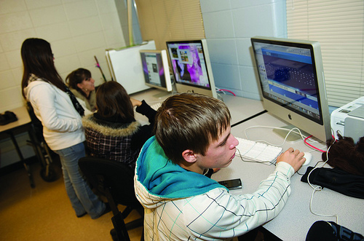
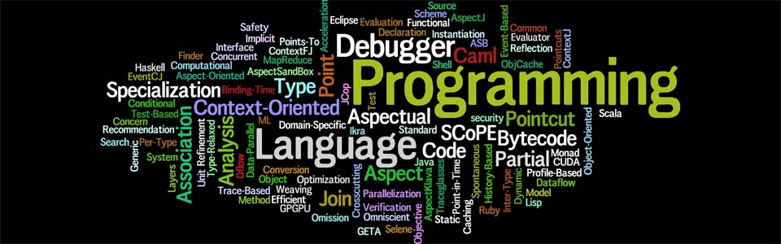
The Team and The Project (3)
One of Google’s older programming groups?

Slide 15
Group Composition
Group composed of members who share the same motivation can be problematic
Task-oriented - everyone wants to do their own thing;
Self-oriented - everyone wants to be the boss;
Interaction-oriented - too much chatting, not enough work.
An effective group has a balance of all types.

Slide 16
Group Composition (2)
This can be difficult to achieve software engineers are often task-oriented.
Interaction-oriented people are very important as they can detect and defuse tensions that arise.

Slide 17
Group Leadership
Leadership depends on respect not ‘title status’.
There may be both a technical and an administrative leader.
Democratic leadership is more effective than autocratic leadership.

Slide 18
Group Cohesiveness (2)
In a cohesive group, members consider the group to be more important than any individual in it.
The advantages of a cohesive group are:
Group quality standards can be developed;
Group members work closely together so inhibitions caused by ignorance are reduced;
Team members learn from each other and get to know each other’s work;
Egoless programming where members strive to improve each other’s programs can be practised.

Slide 19
Developing Cohesiveness
Cohesiveness is influenced by factors such as the organisational culture and the personalities in the group.
Cohesiveness can be encouraged through
Social events;
Developing a group identity and territory;
Explicit team-building activities.
Openness with information is a simple way of ensuring all group members feel part of the group.

Slide 20
Group Loyalties
Group members tend to be loyal to cohesive groups.
'Groupthink' is preservation of group irrespective of technical or organisational considerations.
Management should act positively to avoid groupthink by forcing external involvement with each group.

Slide 21
Group Communications
Good communications are essential for effective group working.
Information must be exchanged on the status of work, design decisions and changes to previous decisions.
Good communications also strengthens group cohesion as it promotes understanding.

Slide 22
Group Communications (2)
Group size
The larger the group, the harder it is for people to communicate with other group members.
Group structure
Communication is better in informally structured groups than in hierarchically structured groups.
Group composition
Communication is better when there are different personality types in a group and when groups are mixed rather than single sex.
The physical work environment
Good workplace organisation can help encourage communications.

Slide 23
Group Organisation
Small software engineering groups are usually organised informally without a rigid structure.
For large projects, there may be a hierarchical structure where different groups are responsible for different sub-projects.

Slide 24
Informal Groups
The group acts as a whole and comes to a consensus on decisions affecting the system.
The group leader serves as the external interface of the group but does not allocate specific work items.
Rather, work is discussed by the group as a whole and tasks are allocated according to ability and experience.
This approach is successful for groups where all members are experienced and competent.

Slide 25
Extreme Programming Groups
Extreme programming groups are variants of an informal, democratic organisation.
In extreme programming groups, some ‘management’ decisions are devolved to group members.
Programmers work in pairs and take a collective responsibility for code that is developed.

Slide 26
Chief Programmer Teams
Chief programmer teams consist of a kernel of specialists helped by others added to the project as required.
The motivation behind their development is the wide difference in ability in different programmers.
Chief programmer teams provide a supporting environment for very able programmers to be responsible for most of the system development.

Slide 27
Problems
This chief programmer approach, in different forms, has been successful in some settings.
However, it suffers from a number of problems:
Talented designers and programmers are hard to find. Without exceptional people in these roles, the approach will fail;
Other group members may resent the chief programmer taking the credit for success so may deliberately undermine his/her role;
.../ continued

Slide 28
Problems (2)
There is a high project risk as the project will fail if both the chief and deputy programmer are unavailable.
The organisational structures and grades in a company may be unable to accommodate this type of group.

Slide 29
Systems Analysis
Bridging the gap between the various stakeholders, defining technical requirements, defining the Information Systems scope.
Skilled at working with end-users to determine what their computational needs are.
The systems analyst has some organisational experience which is useful in determining if a user's requests are feasible – but, really, their perspective is mainly that of the technology.

Slide 30
What a Systems Analyst Does
Conducts feasibility studies (with alternatives)
Liaises with users and determines requirements
Finds out facts important to the design of the proposed system
Determines human and computer procedures that will make up the new system
Designs data storage (files) and interfaces
Writes program specifications
Tests programs and systems
Designs implementation procedures
Documents the system
Plans, monitors and controls the systems development
Reviews how successful the project was
Oversees the maintenance of the system

Slide 31
Systems Analyst Skills
Systems Thinking – the analyst must
understand systems concepts
be able to apply systems thinking to Information Systems
Organisational Knowledge – the analyst must
be able to identify processes / internal politics
be able to negotiate the competitive and regulative environment / strategies and tactics
The analyst must be good at problem Identification, problem/situation analysis and problem solving.

Slide 32
Systems Analyst Skills (2)
Technical Skills -
understanding hardware / software
be willing to become involved in publications / professional societies / courses and conferences
Management Skills -
have some capability in resource management / project management – as well as
risk management / change management / people management
Interpersonal Skills – analysts must
have communication skills / working alone and in teams
be able to facilitate groups / manage expectations

Slide 33
Specialist Skills
IT Systems Analysts used to do all these tasks but computing is getter ever more complex. It is beyond the capability of one person…
Specialisms have emerged. Systems analysts may work in specific areas such as;
Business Analysis
Data Analysis
Networking
Communications … World-Wide Web (WWW) … etcetera.
Notes:
Important to stress that it is now impossible for one person to have all the necessary skills
Systems are getting more complex,
Business .. Computers.. Communication ..
Refer to computer weekly etc for them to see the variety of skills required.
One of the key modern trends is the separation of Business requirements, i.e. Business Analyst
The general analyst is now often a project manager, coordinating specialist skills

Slide 34
The Role of the Systems Analyst
Rules for roles of Systems Analysis
Do not assume that a computer system is the solution
“Computerising a bad system gets you into trouble faster”
Analysts do not decide the best solution
The client must decide from options given
The underlying business process must be sustainable

Slide 35
Analysis and Design
Project Selection
Analysis is the problem solving stage
Feasibility
Study
Systems
Investigation
Systems
Analysis
Systems
Design
Systems
Implementation
Design is building upon the analysis to develop the selected solution
Review &
Maintenance

Slide 36
Design
“Stating how a system will be constructed without actually building it.” (Rumbaugh)
A construction industry corollary;
Sketch plans
Outline
Detail
Written Specifications ….THEN
Actual construction (For Information Systems, that would be a good idea!)
Notes:
Construction industry is a good example – NEVER JUST START BUILDING
Ie “Hacking it”
So why do so many programmers start this way?
Pre meditated actions, progressively considering detail
To (try and) ensure successful outcome.

Slide 37
When to Design?
Alongside construction (e.g. Just In Time?)
Alongside Analysis (finding solutions to problems as we go along – often only in outline)?
After the analysis stage (e.g. detailed design)?
Or both – as in rapid development (RAD – Rapid Application Development – or prototyping).
Notes:
Modern trend towards concurrent engineering
Useful to white board these in chart/diagram form
Ie design just enough in front to enable production (programming) to start
Can be high risk, but much faster development time
Rapid Application, Analyse a bit, design a bit, build a bit … iterations
Will depend on life cycle model being followed
Importance of independence of design (logical) for portability and extended system life – can be easily implemented on a new (perhaps as yet unknown) platform.
But tends to slow development down, as it is an interim stage. Much used with Structured Systems Methodologies.

Slide 38
Analyst as Designer
Does a systems analyst get involved in systems design?
Sometimes.
There follows a few points about design that are pertinent to an analyst/designer or an analyst/programmer.

Slide 39
When to Design?
By the way, there is usually a distinction between ‘Logical Design’ and ‘Physical Design’.
Why?
There is an independence of the physical implementation.
Notes:
Modern trend towards concurrent engineering
Useful to white board these in chart/diagram form
Ie design just enough in front to enable production (programming) to start
Can be high risk, but much faster development time
Rapid Application, Analyse a bit, design a bit, build a bit … iterations
Will depend on life cycle model being followed
Importance of independence of design (logical) for portability and extended system life – can be easily implemented on a new (perhaps as yet unknown) platform.
But tends to slow development down, as it is an interim stage. Much used with Structured Systems Methodologies.

Slide 40
Systems Analysis and Design
Slide 35 showed the ‘Waterfall Model’ of Systems Analysis – it is, essentially, a Life Cycle.
It began with ‘Project Selection’ but this could also be termed, ‘Fact Finding’ with variant stages (or phases) thereafter – up until the design phase.

Slide 41
Systems Analysis and Design (2)
So, for example, Requirements Modelling comes immediately after Fact-Finding logically.
Practically speaking, it is impossible to separate the two.
Analysts generally model as they go along so the Design phase might be reached via this model.

Slide 42
Systems Analysis and Design (3)
Next step - Requirements Analysis
After that, Design
Only when we fully understand the problem, can we develop a complete solution.
(In practice, developers often begin designing parts of the solution earlier)
A Life Cycle emerges.

Slide 43
Systems Analysis and Design (4)
Fact-Finding + Requirements Modelling + Requirements Analysis = the entire Systems Analysis activity.
For a strictly waterfall lifecycle:
Fact-Finding
Modelling
Analysis

Slide 44
Systems Analysis and Design (5)
As an iterative (repeated, looped) activity (common even within a Waterfall Life Cycle)
Requirements Modelling
Learn a bit about the problem
Model what you learned
Fact-finding
Analyse its structure and implications
Requirements Analysis

Slide 45
Systems Analysis and Design (6)
Example of a fully iterative Life Cycle:
Learn some facts
Review what was learnt
Model the facts
Analyse the model
Test what you built
Build a bit of solution
Design a bit of solution

Slide 46
Up Next
Next week’s lecture title is:
Managing complexity

